Slide 1
W3C Web of Things Retail Demo Scenario
Michael McCool
3 May 2022
Conexxus Conference

Slide 2
Outline
What is WoT?
Applying and extending web standards for IoT
Descriptive interoperability
Test Scenario: Cooler Monitor
Hub architecture
Desired behavior and devices
Implementations
Options
Home Assistant and Node-RED Prototypes
Discussion
Semantic interoperability

Slide 3




W3C Web of Things (WoT)
W3C Working Group goal: Adapting web technologies to IoT
Already published: Thing Description (TD) metadata format
TD describes the available interactions (network API) of a Thing
New deliverables in progress, including Discovery
How does a potential user obtain the TD for a Thing?
App
App
App
App
App
App
WoT API
WoT API
WoT API
{ properties, actions, events }
MQTT
KNX
TLV
ECHONET
Bearer
EXI
HTTP
OAUTH2
WS
XML
MQTT
KNX
TLV
ECHONET
Bearer
EXI
JSON
Modbus
CBOR
OPC-UA
API Key
HTTP
OAUTH2
CBOR
WS
XML
BACnet
AMQP
JSON
Modbus
BACnet
OPC-UA
API Key
AMQP

Slide 4
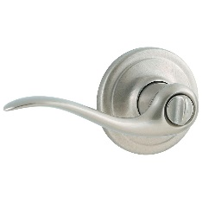
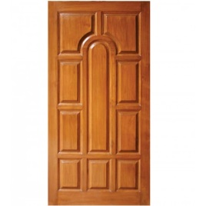
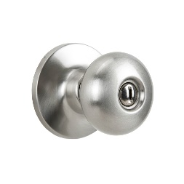
Descriptive Interoperability: TDs
WoT Architecture
Constraints
"Things" must have a TD
Must use URIs, IANA media types, etc.
Thing Description Affordances
Describes WHAT the possible choices are
Describes HOW to interact with the Thing
WoT Thing Description (TD)
{
"@context": [
"https://www.w3.org/2022/wot/td/v1.1",
{ "iot": "http://iotschema.org/" }
],
"id": "urn:dev:org:32473:1234567890",
"title": "MyLEDThing",
"description": "RGB LED torchiere",
"@type": ["Thing", "iot:Light"],
"securityDefinitions": {
"default": {"scheme": "bearer"}
},
"security": ["default"],
"properties": {
"brightness": {
"@type": ["iot:Brightness"],
"type": "integer",
"minimum": 0,
"maximum": 100,
"forms": [ ... ]
}
},
"actions": {
"fadeIn": {
...
Pull
Handle = Affordance
What?
How?
Door = Thing
Open
Turn

Slide 5
Usage Patterns Overview

Slide 6
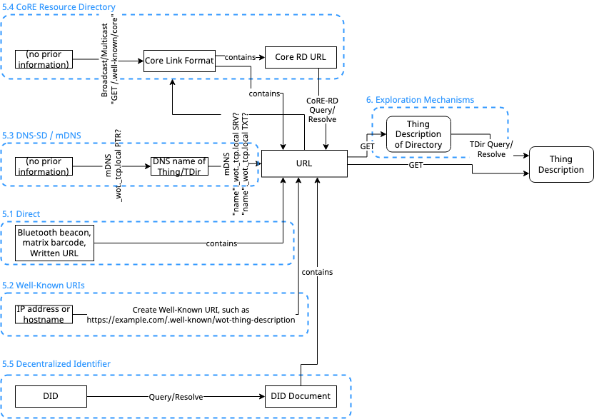
Discovery
Goal: Obtain TD of interest
Not limited to local network
Scalable to many TDs
Need to preserve privacy
Phased access:
Introduction: open
Exploration: controlled
Searchable via JSON Path, XPath, or SPARQL
Future work:
Find "nearby" Things using geospatial data
Phase 1: Introduction
Phase 2: Exploration

Slide 7

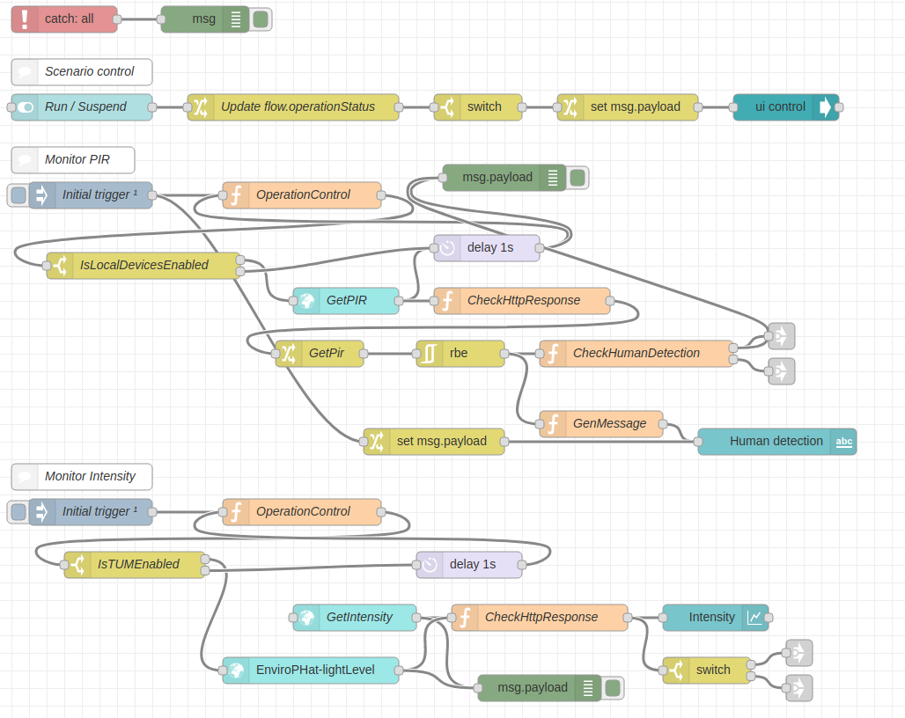
Orchestration
node-wot/Scripting API
WoTHelpers.fetch( "coap://localhost:5683/counter" ).then( async (td) => {
// using await for serial execution (note 'async' in then() of fetch())
try {
const thing = await WoT.consume(td);
console.info( "=== TD ===" );
console.info(td);
console.info( "==========" );
// read property #1
const read1 = await thing.readProperty( "count" );
console.info( "count value is" , await read1.value());
// increment property #1 (without step)
await thing.invokeAction( "increment" );
const inc1 = await thing.readProperty( "count" );
console.info( "count value after increment #1 is" , await inc1.value());
// increment property #2 (with step)
await thing.invokeAction( "increment" , {'step' : 3});
const inc2 = await thing.readProperty( "count" );
console.info( "count value after increment #2 (w/ step 3) is" , await inc2.value());
// decrement property
await thing.invokeAction( "decrement", undefined, {
formIndex: getFormIndexForDecrementWithCoAP(thing);
} );
const dec1 = await thing.readProperty( "count" );
console.info( "count value after decrement is" , await dec1.value());
} catch(err) {
console.error( "Script error:", err);
}
}).catch( (err) => { console.error( "Fetch error:", err); });
Node-RED/node-gen

Slide 8

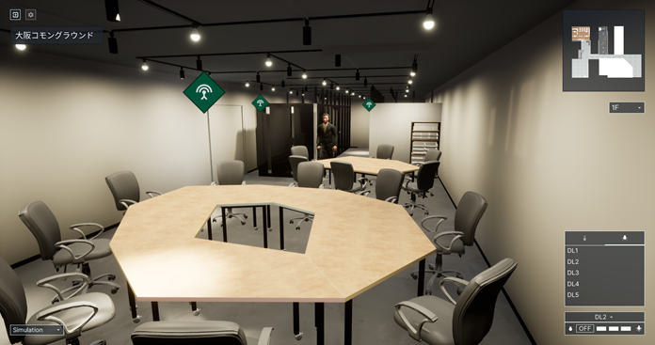

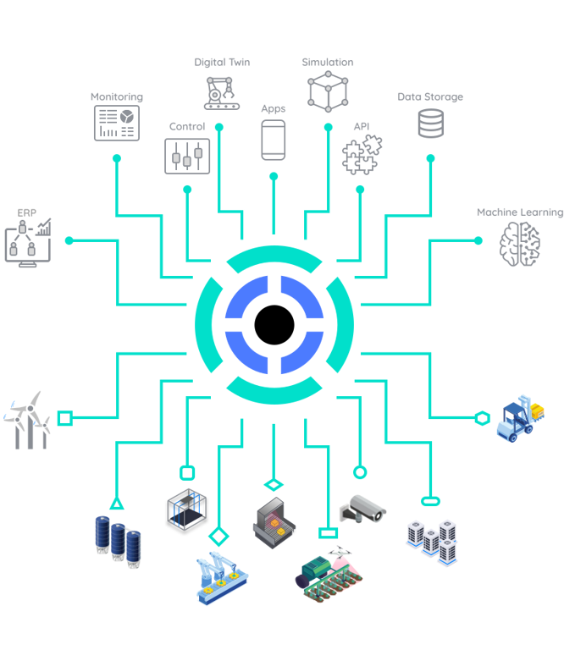
Applications
https://new.siemens.com/global/en/products/buildings/automation/desigo.html
https://www.evosoft.com/en/digitalization-offering/saywot/
Siemens
Desigo CC – BIM
Say WoT!
https://www.takenaka.co.jp/news/2021/05/02/
Takenaka Corporation
CGLL Platform - BIM
https://www.eclipse.org/ditto/2022-03-03-wot-integration.html
Bosch
Eclipse Ditto - Digital twin
https://netzo.io/
Netzo
IoT Data Hub
Dashboards

Slide 9




Test Scenario: Cooler Monitor
Door Sensor
Remote Access
Cooler
Temperature Gauge
Hub
Protocol Gateway
Rule Engine
TD
TD
TD
TD
Multi-color Light
TD
TD
Other
HTTP

Slide 10
Why a Hub?
Protocol translation
Data translation
Other services
Historical data
Dashboards
Rules engine (automation)
Shadowing
Caching state of sleeping devices
Queuing commands to sleeping devices
Important for battery-powered devices
Secure Remote Access

Slide 11
Desired Behavior
Door Open Alert
Temperature Out of Range
If the cooler door has been left open for more than a certain time: flash light.
If the door is closed: cancel flashing
If internal freezer temp is too low: turn light BLUE
If internal freezer temp is too high: turn light RED
If internal freezer temp is normal: turn light WHITE
NOTE:
Rules should co-exist.
→ If door is open and temps are high, light should be RED and flashing

Slide 12
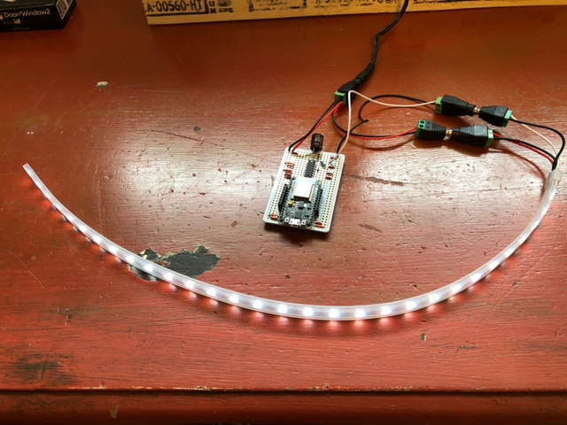
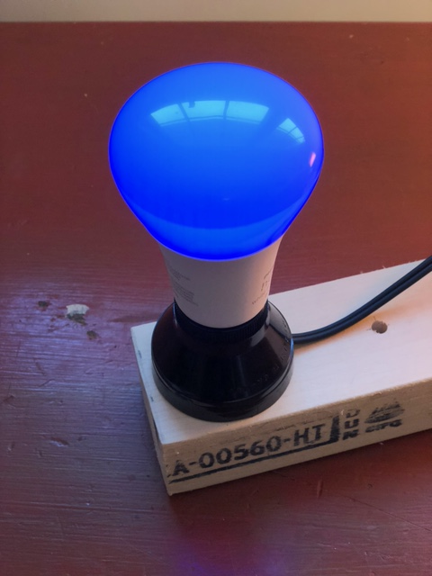
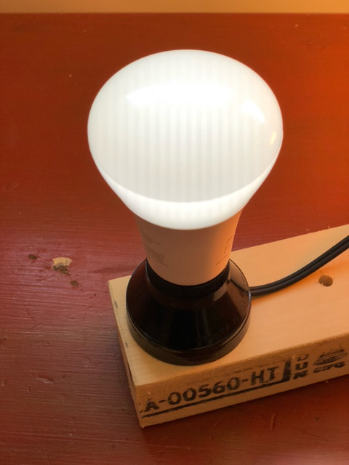
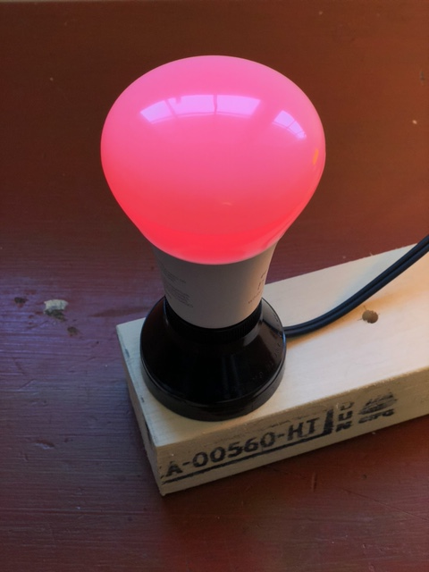
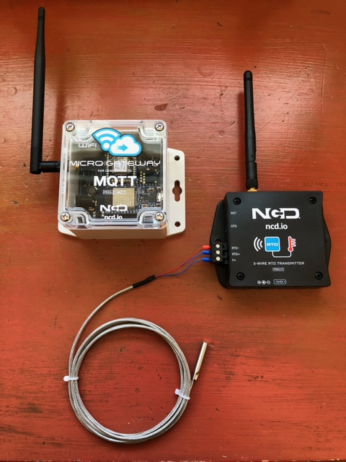
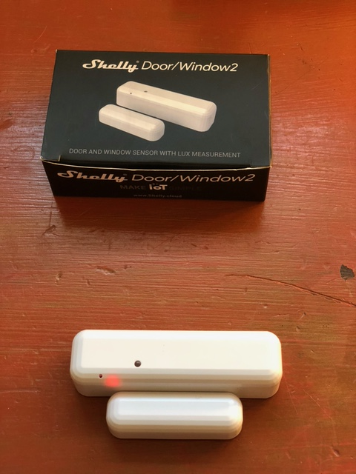
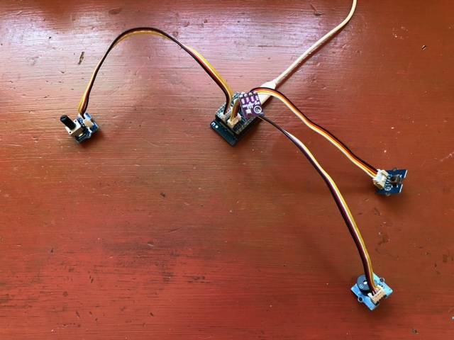
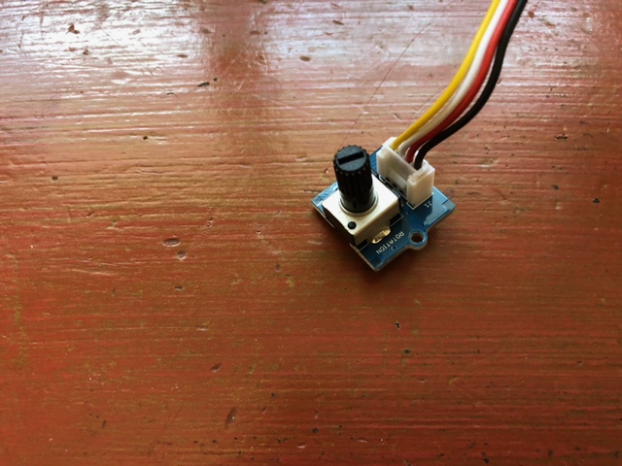
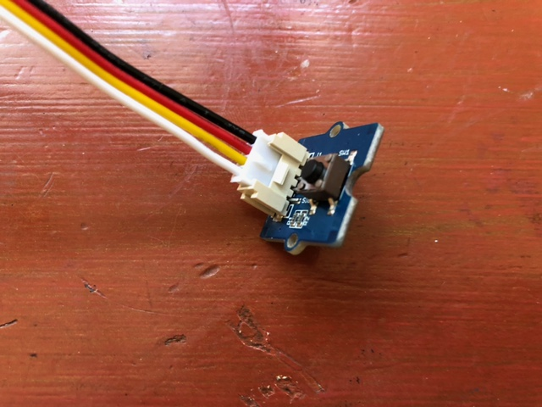
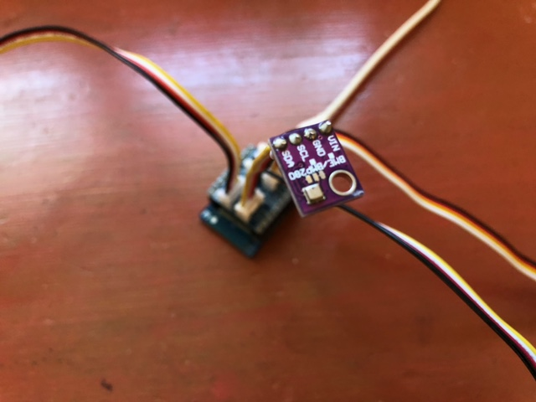
Devices
Test Devices
Commercial Devices

Slide 13
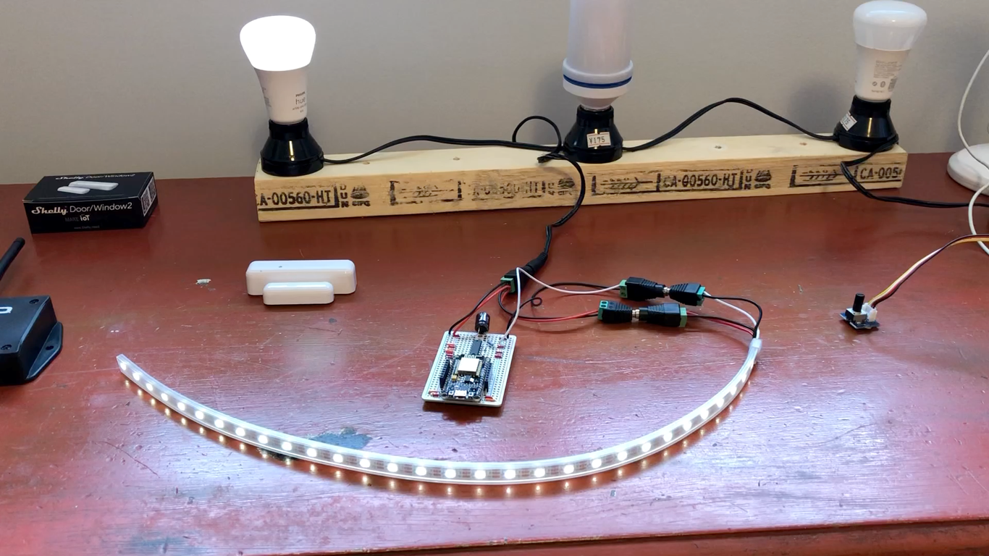
Video: System Demo
https://youtu.be/m0F11Vu2wf8

Slide 14
Implementation Approaches
Proprietary Turnkey System
Contract out entire system to a third party
Issues: Maintenance, modifications, ownership transfer, business risk
Proprietary Gateway/Rules Engine (e.g. Smart Things)
Integrations limited to those provided by vendor, business risk, portability
Open-source Gateway/Rules Engine (e.g. Home Assistant, Node-RED)
Crowdsourced integrations, variable quality, business risk, portability
Standards-based Gateway/Rules Engine (e.g. node-wot)
Subclass of Proprietary and Open-Sourced Gateways
Addresses portability concern, which also helps to address business risk

Slide 15
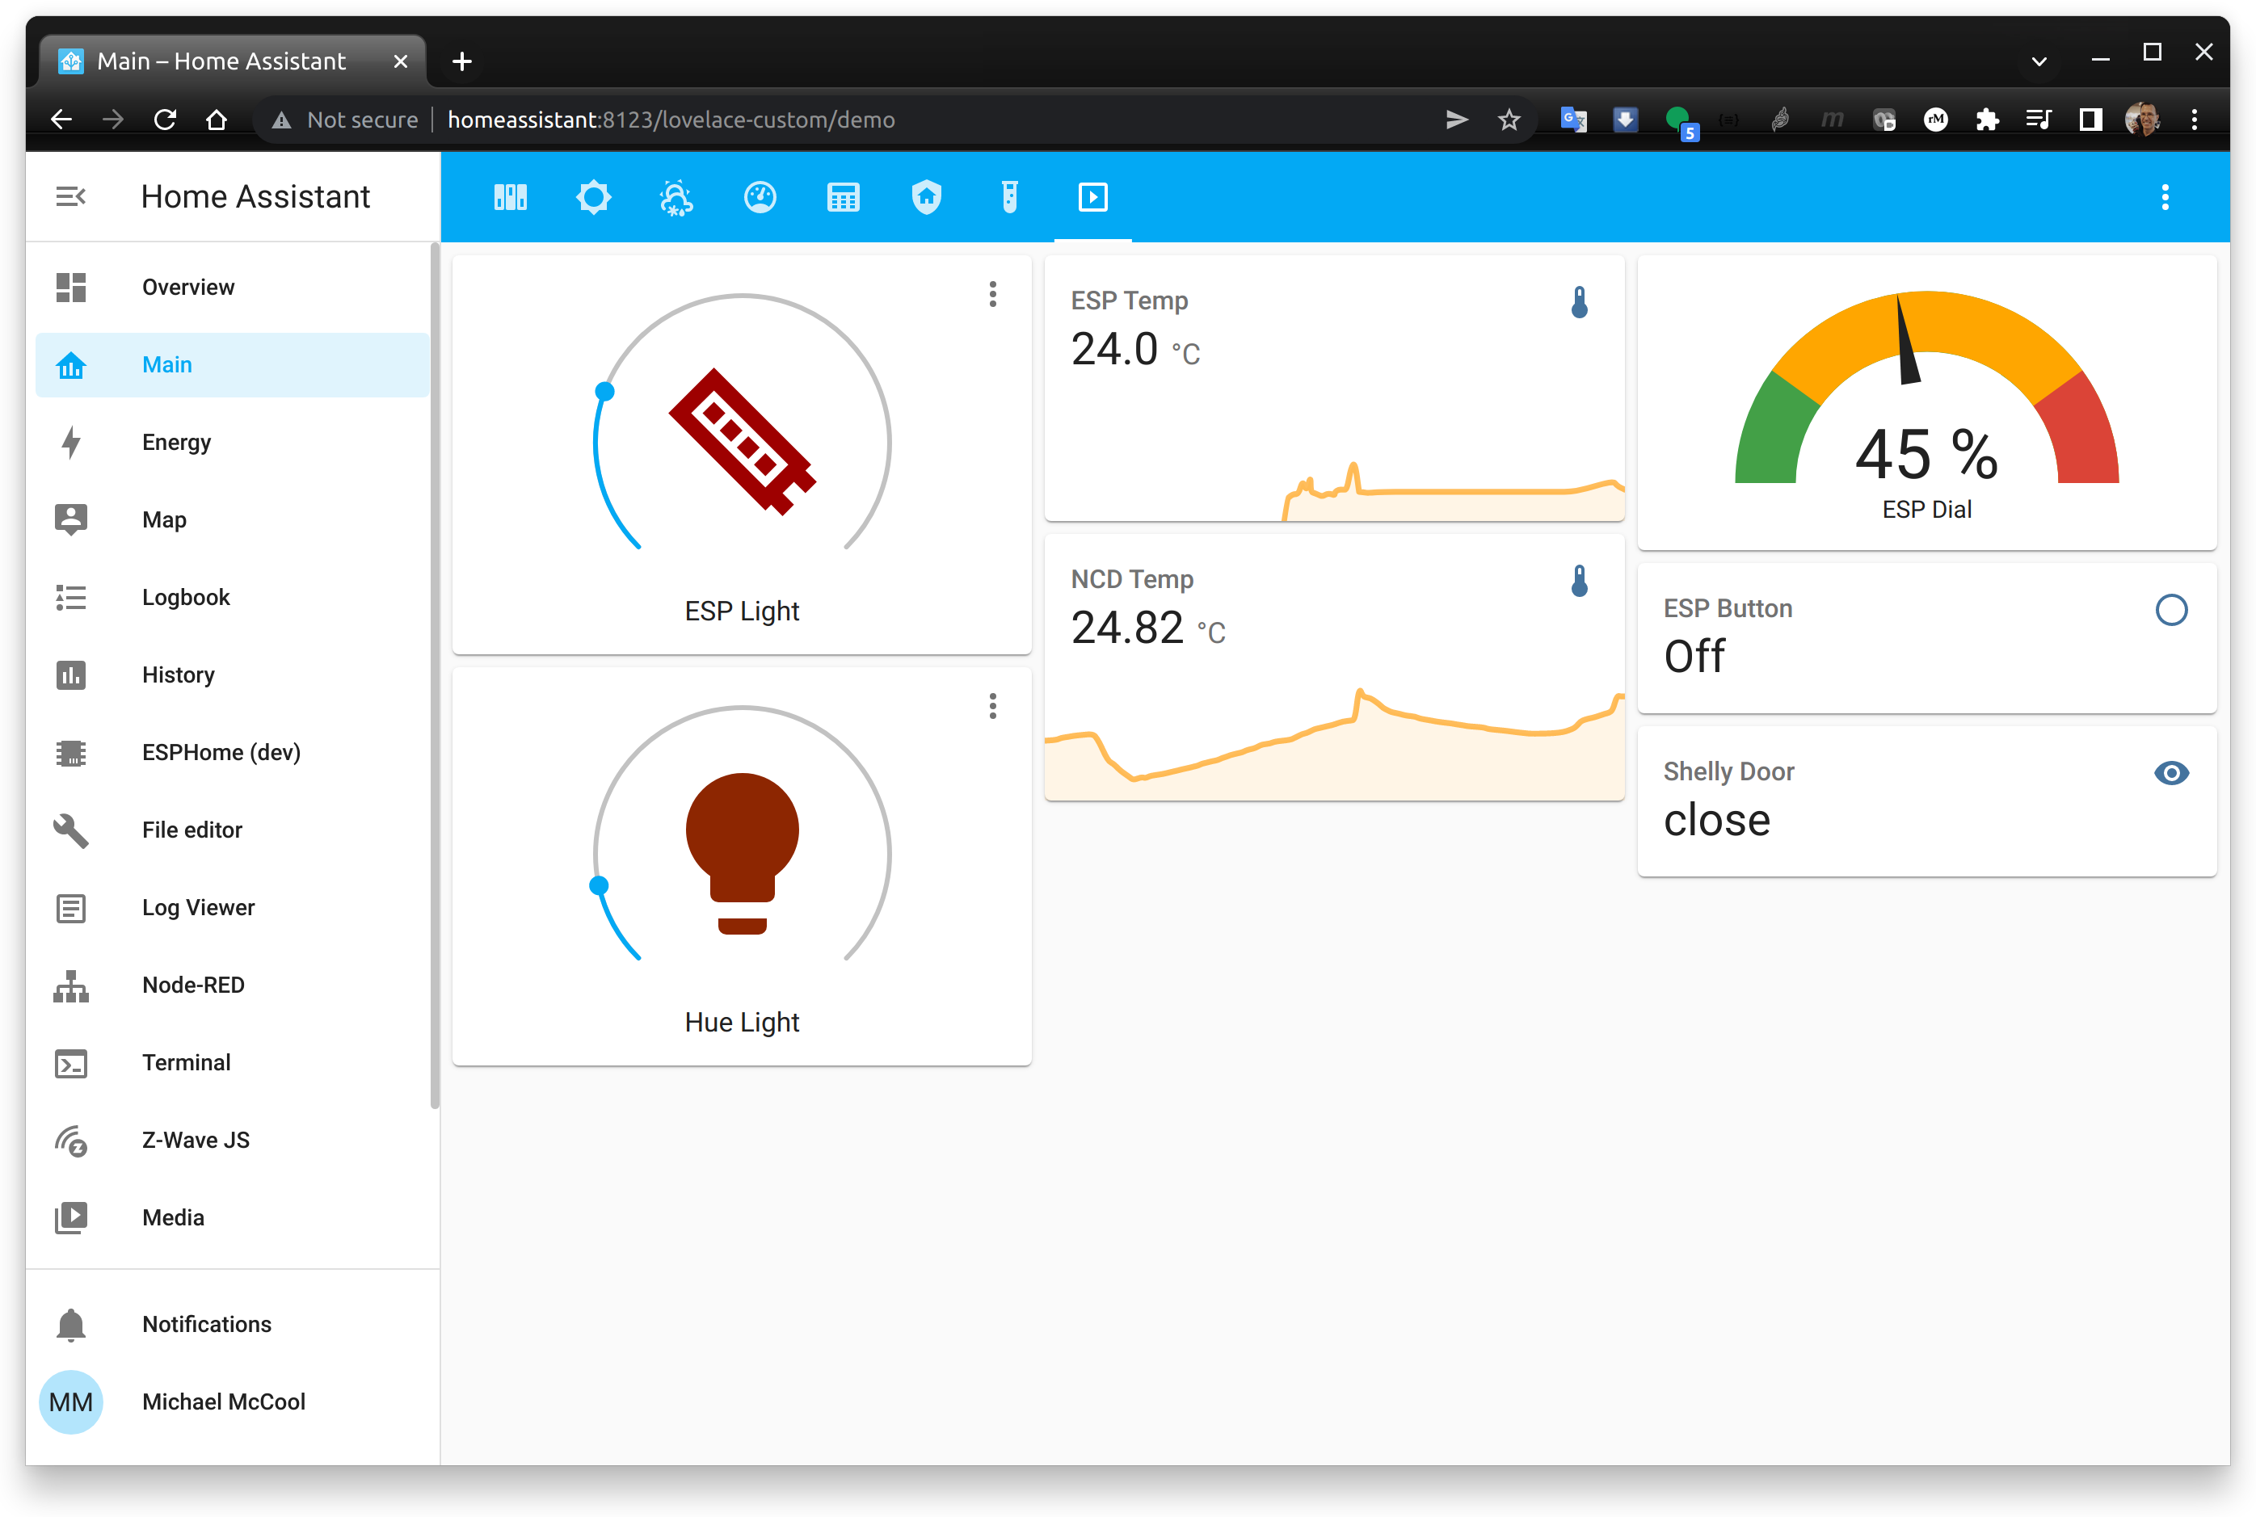
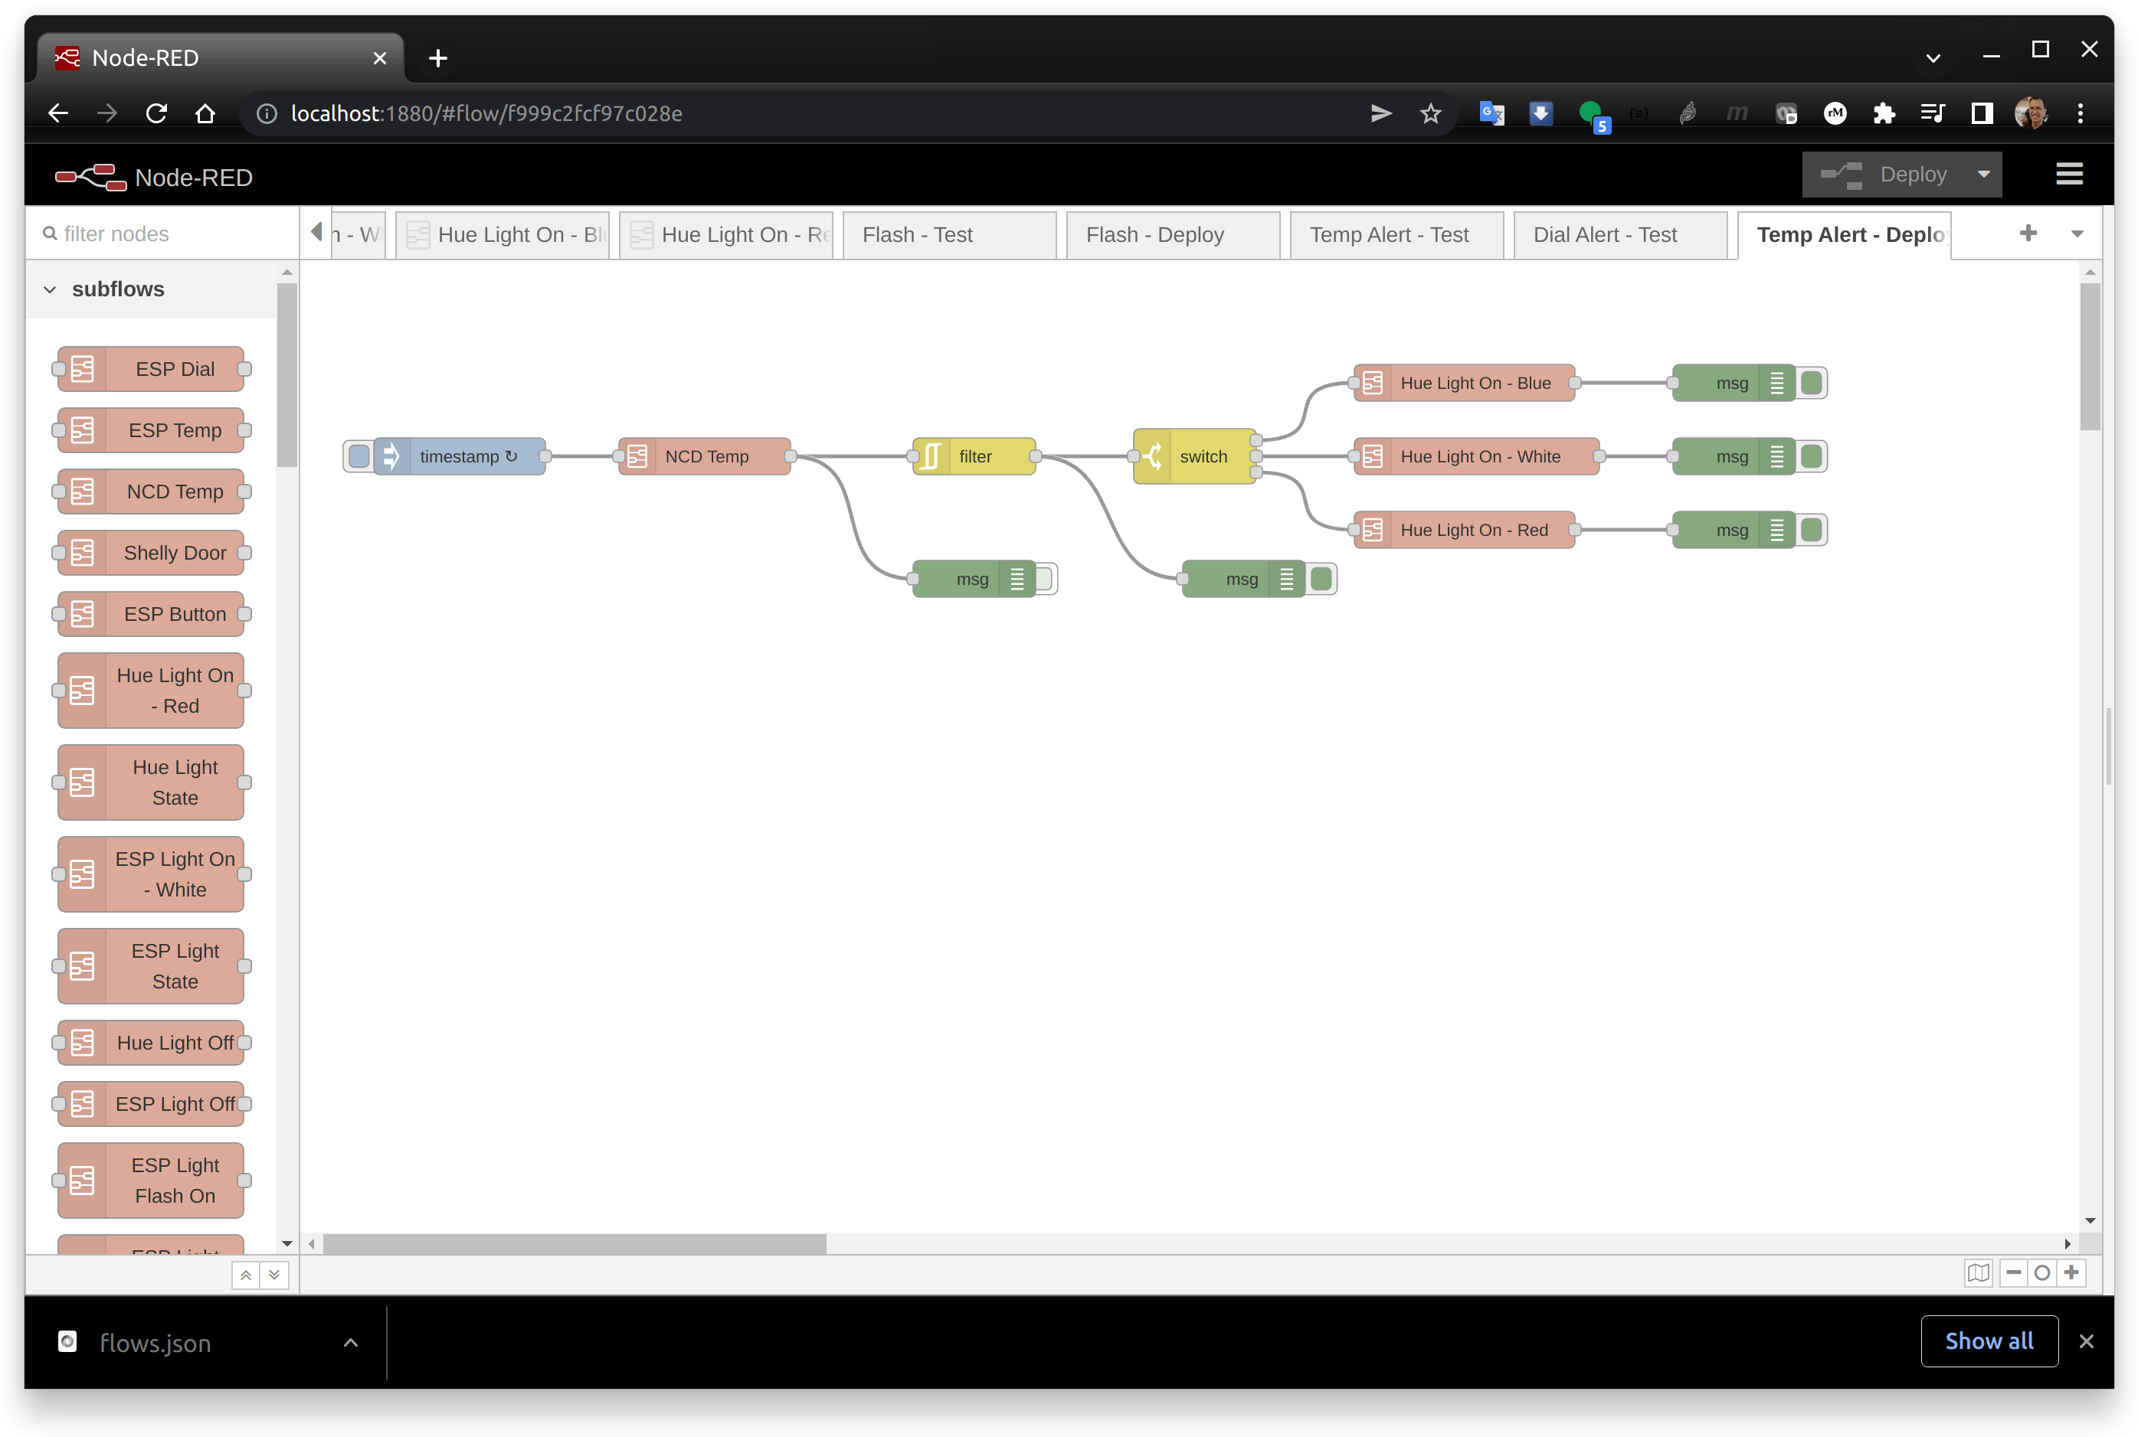
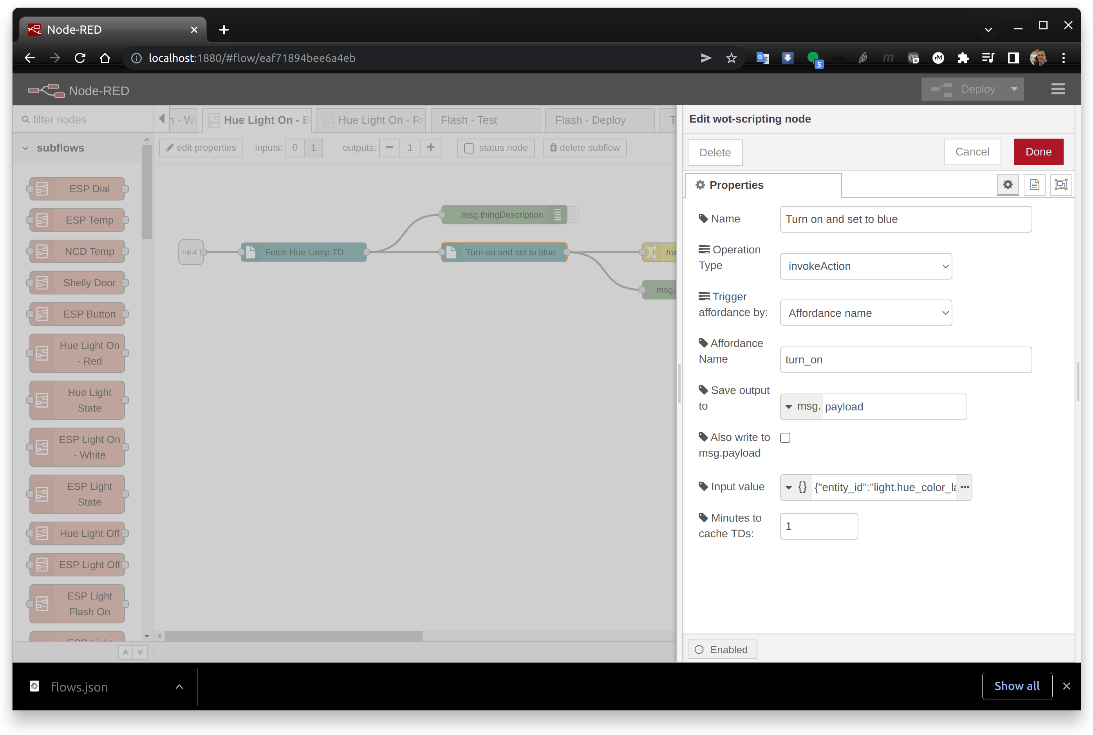
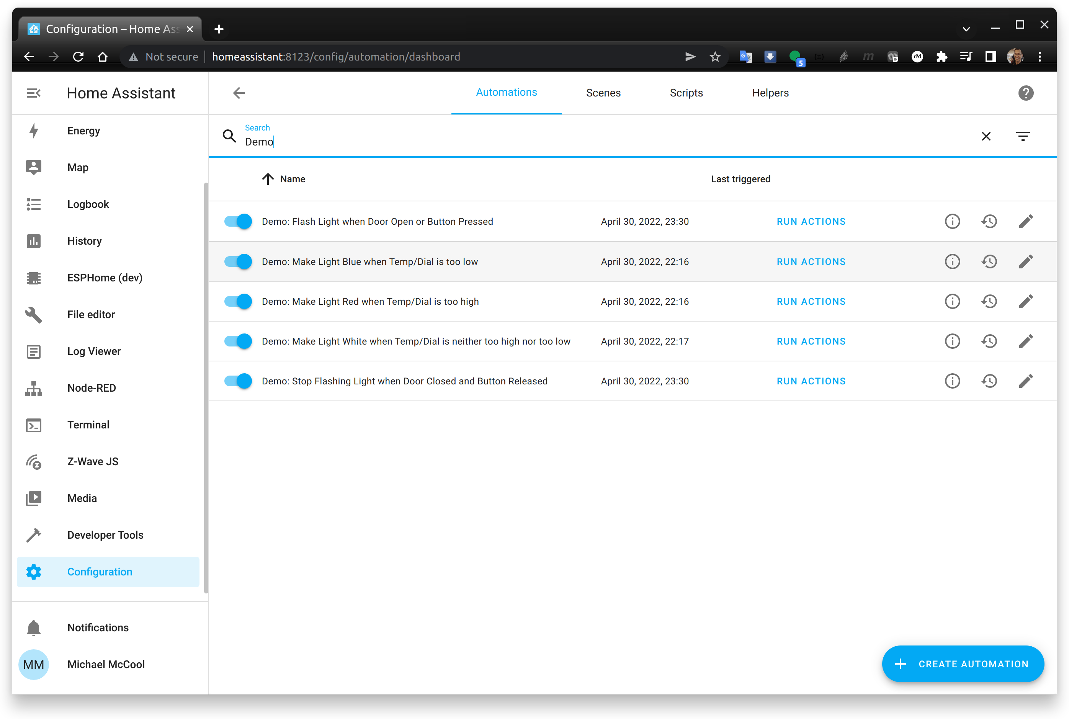
Two Implementations
Home Assistant Native Rules
Node RED
Use built-in rules engine
Rules based on WoT TD/node-wot

Slide 16
Home Assistant – Native Rule Engine
HA is used as a "typical" gateway
EdgeX Foundry would be more appropriate for retail
Frontend provides an HTTP API
Backend supports a variety of device/ecosystem integrations
Hue is HTTP (proxy to Zigbee)
NCD Temp is MQTT
Shelly is MQTT and HTTP
Test RGBW strip, dial, button, and temp sensors are MQTT and HTTP, generated via ESPHome
Automation rules are based on HA-specific YAML configuration scripts

Slide 17
Home Assistant – Dashboard

Slide 18
Home Assistant – Rules

Slide 19
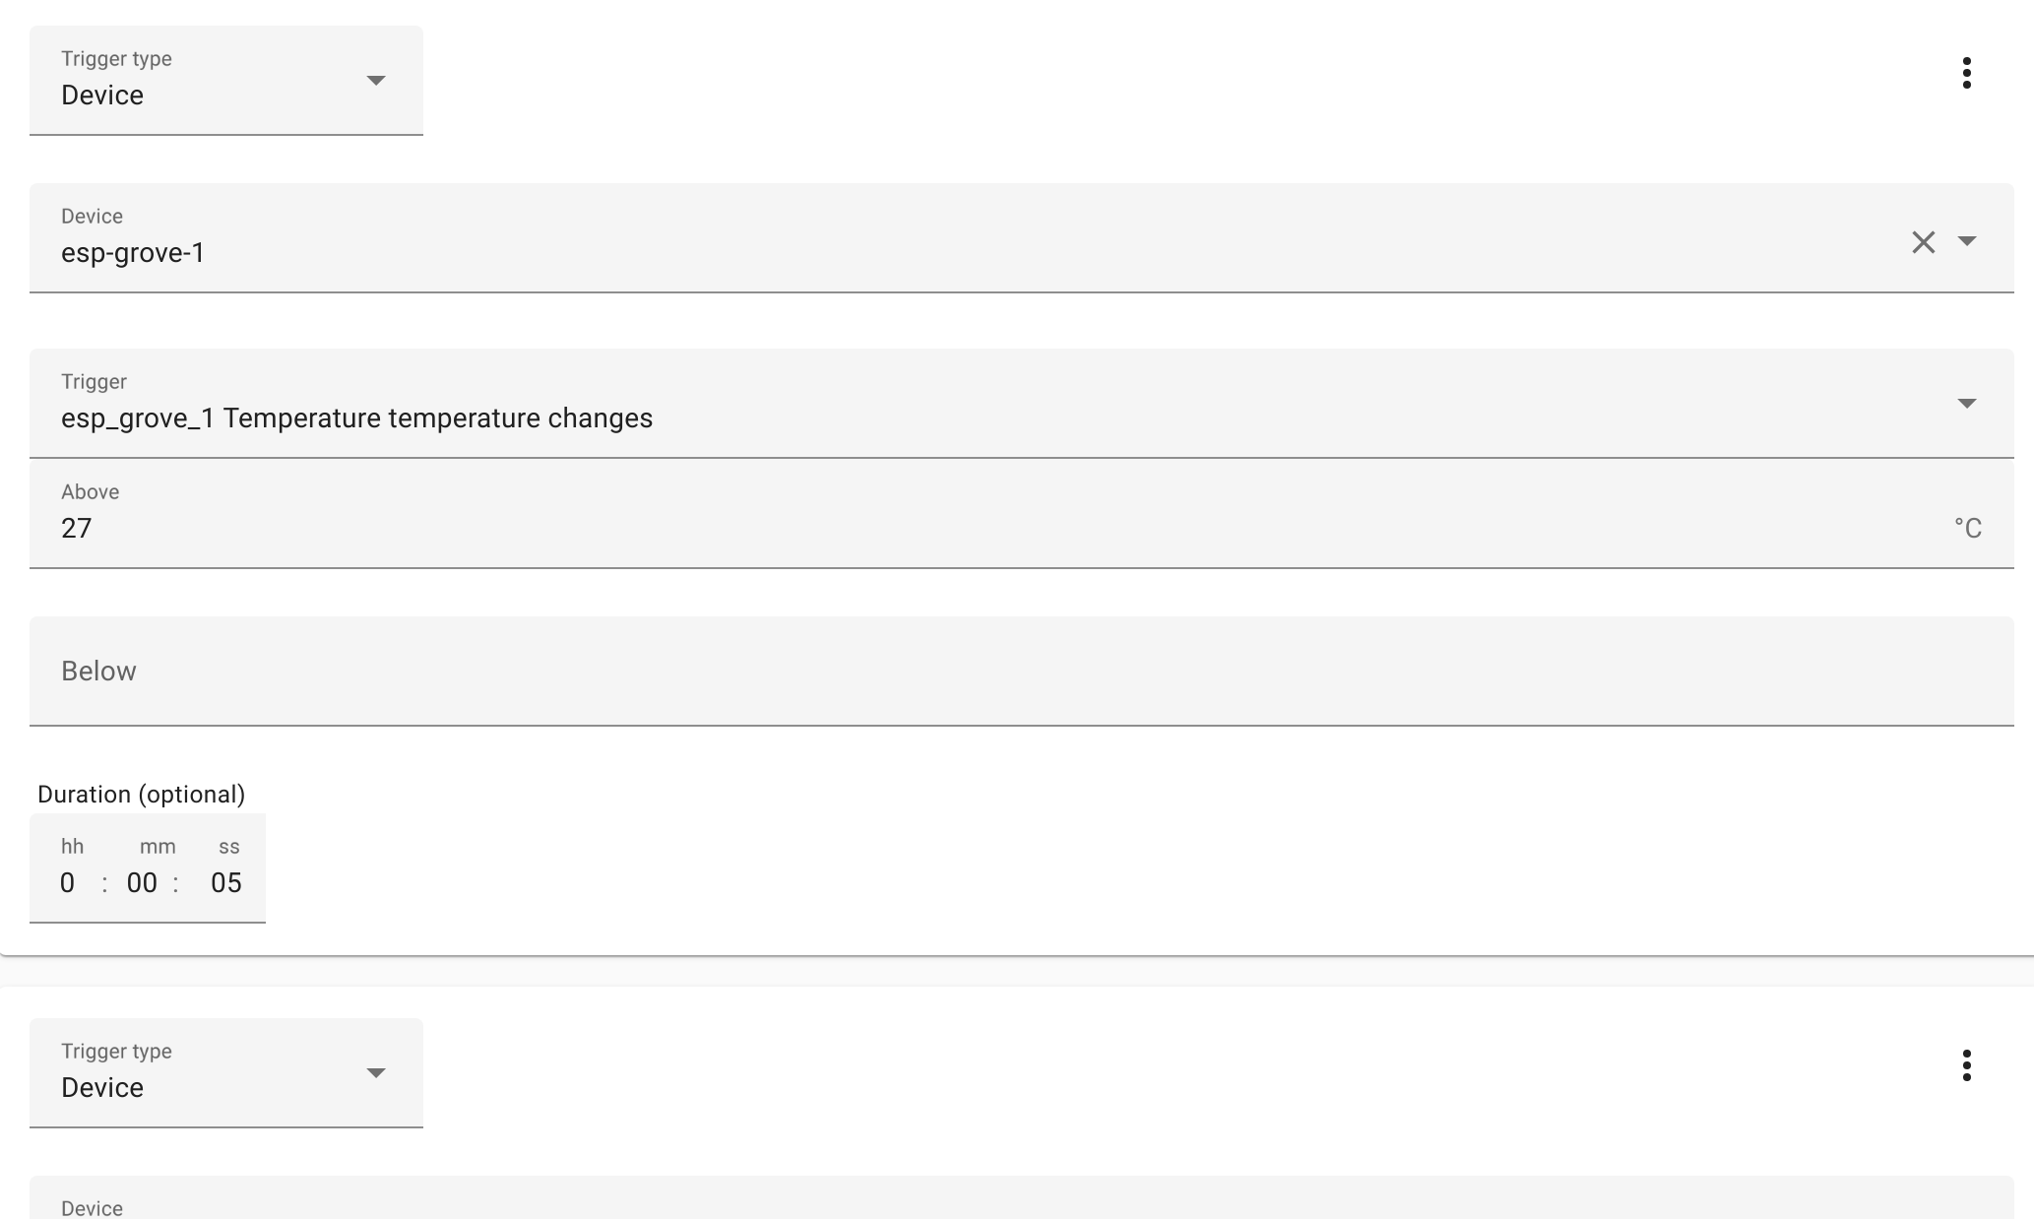
Home Assistant – Temp High Rule

Slide 20
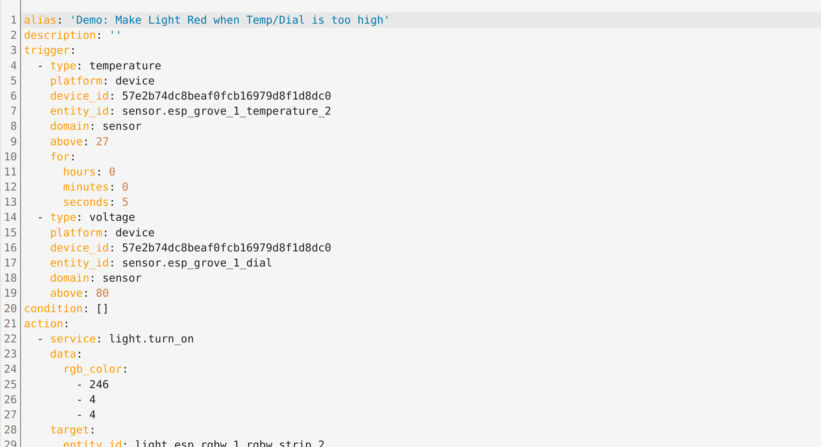
Home Assistant – Temp High Rule

Slide 21
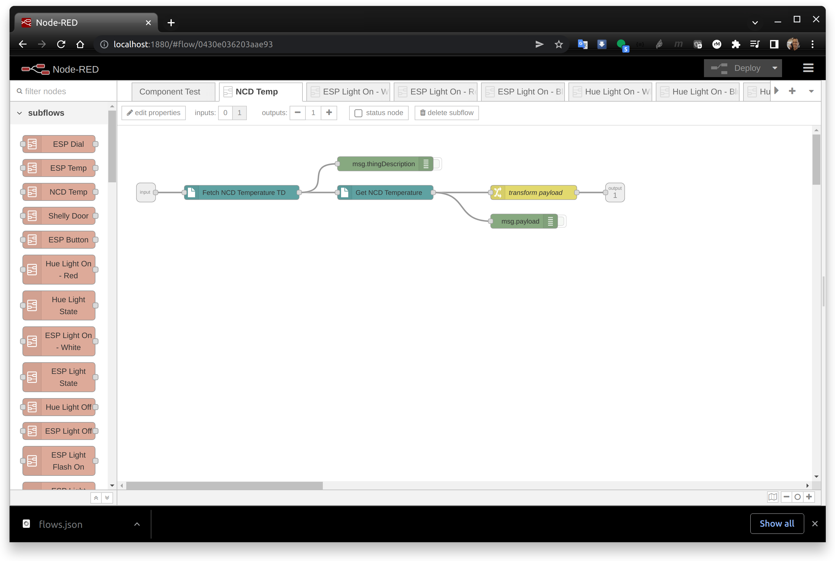

Node-RED/WoT Discovery
Node-RED is an open-source rule engine
An extension can be used to discover WoT TDs and interface to what they describe
In the demo we use HA as a gateway
HOWEVER, we could also talk directly to devices via MQTT (for example), given a suitable WoT TD
Automation rules are based on Node-RED "flows"

Slide 22
Node-RED – Temp Rule

Slide 23
Node-RED Subflows

Slide 24
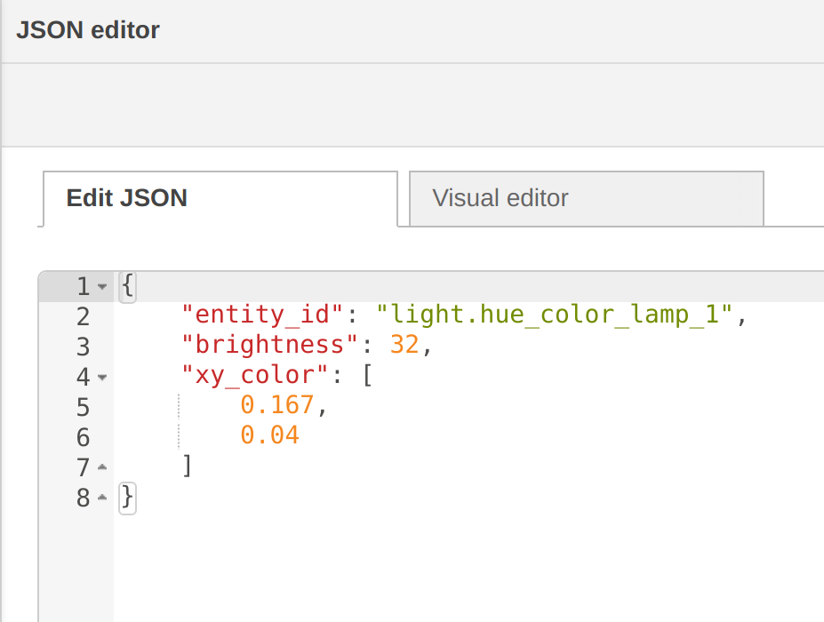
Interoperability
WoT TDs describe device interfaces in a standard way
Interactions are now is protocol and payload encoding independent
HOWEVER, devices that do the "same" thing may still have different data models and behavior...

Slide 25
Semantic Interoperability
WoT Thing Descriptions
Currently address "syntactic interoperability"
Transform multiple protocols into a common interaction abstraction
Transform multiple payload encodings into a common format (JSON)
Next Steps
Annotating Thing Description with semantics
Transform data into a standardized data model
WoT TDs are encoded using JSON-RD, which provides for semantic annotation and inferencing
Still need (Conexxus can contribute here):
Use cases driving required operations and behavior
Common semantic vocabularies
Standardized data models

Slide 26
Resources and Contacts
https://www.w3.org/WoT
Dr. Michael McCool
Principal Engineer
Intel
Technology Pathfinding
michael.mccool@intel.com
Dr. Sebastian Kaebisch
Senior Key Expert
Siemens
Technology
sebastian.kaebisch@siemens.com

